Slide 1
Smart Air Quality Monitoring System Using ESP32 and IoT

Slide 2
PROBLEM STATEMENT
With the rapid pace of urbanization and industrial growth, air pollution has become a serious environmental and public health concern. Most individuals remain unaware of the quality of the air they breathe indoors, where they spend a significant portion of their time. Traditional air quality monitoring systems are often expensive, bulky, and lack real-time remote accessibility, making them unsuitable for personal or small-scale use.
There is a need for a cost-effective, portable, and IoT-enabled air quality monitoring system that can measure key environmental parameters such as temperature, humidity, and concentration of harmful gases (e.g., NH₃, CO₂, benzene, smoke) in real time. The solution should not only display the data locally for immediate awareness but also allow remote monitoring through mobile devices, empowering users to make informed decisions about their health and surroundings.

Slide 3
abstract
Developed a low-cost IoT-based system using ESP32 to monitor indoor air quality in real time.
Integrated MQ135 gas sensor to detect pollutants (NH₃, CO₂, benzene, smoke) and DHT11 for temperature and humidity.
Displayed live data on a 16x2 LCD via I2C interface for on-site feedback.
Enabled remote monitoring through the Blynk mobile app, using Wi-Fi to push data to the cloud.
Designed for easy deployment in homes, classrooms, labs, and offices, promoting environmental awareness and smart living.

Slide 4

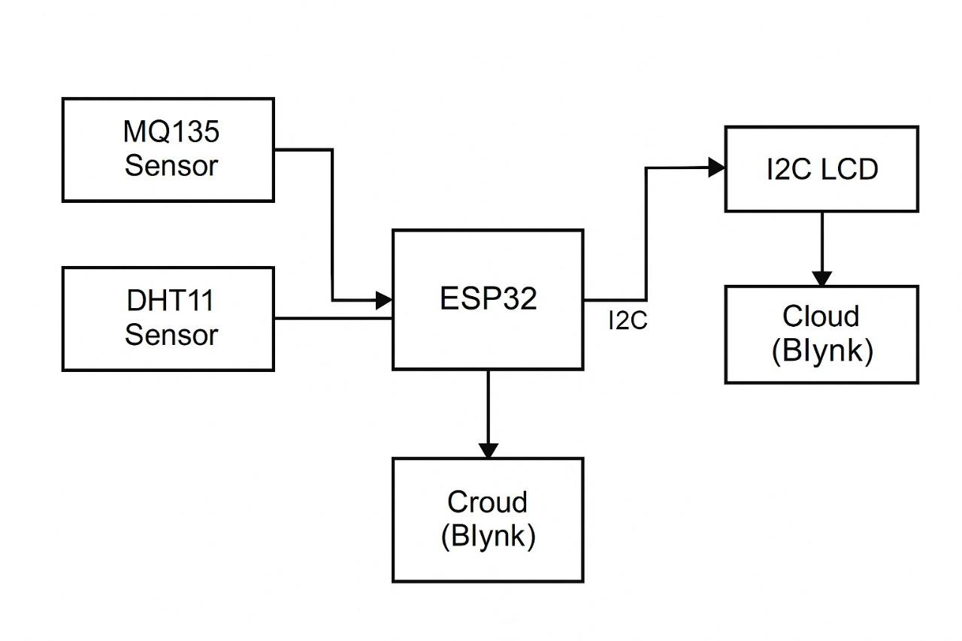
BlOCK DIAGRAM

Slide 5
HARDWARE USED
Component |  | Function
ESP32 |  | Central microcontroller; manages sensing, display, and cloud connection
MQ135 |  | Detects gases like CO₂, NH₃, smoke
DHT11 |  | Measures temperature and humidity
I2C LCD 16x2 |  | Displays live sensor data
Breadboard & Wires |  | For prototyping the circuit layout
USB Power |  | Provides power to the ESP32 module

Slide 6
SOFTWARE USED
Arduino IDE
Used to program the ESP32 board.
Manages sensor readings, LCD output, and Wi-Fi/Blynk connectivity.
Blynk IoT Platform
Used for remote data monitoring.
Provides real-time values of temperature, humidity, and gas level.
Libraries Used
BlynkSimpleEsp32.h: For Blynk integration
DHT.h: For DHT11 interfacing
Wire.h and LiquidCrystal_I2C.h: For I2C LCD display
WiFi.h: For Wi-Fi management
Program Logic Sensor Read → Display on LCD → Upload to Blynk cloud

Slide 7
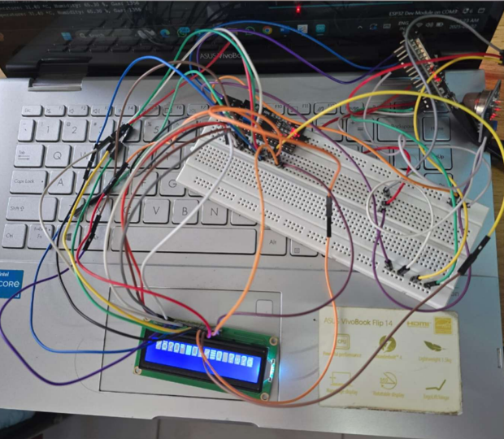
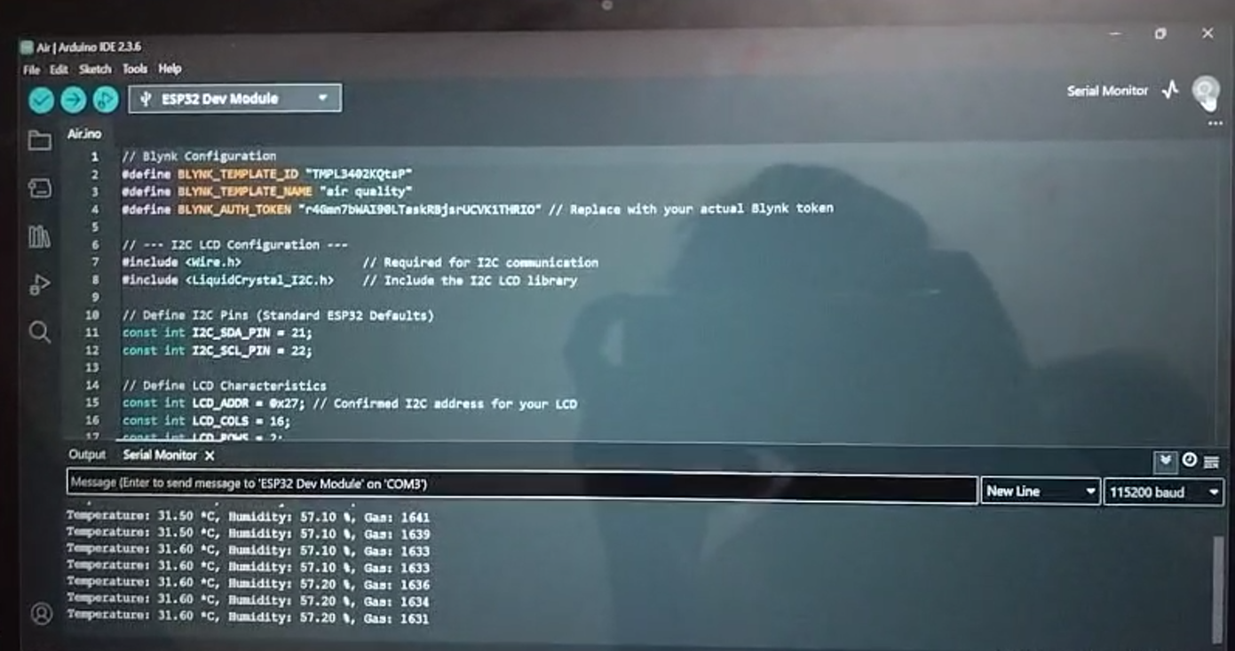
IMPLEMENTATION
Hardware part SOFTWARE PART

Slide 8
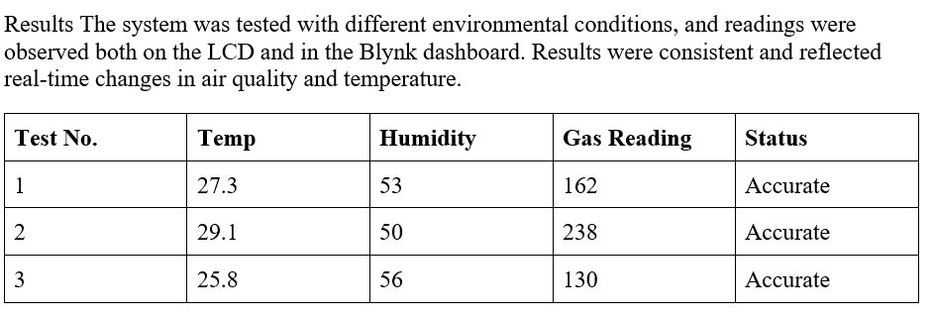
RESULTS

Slide 9
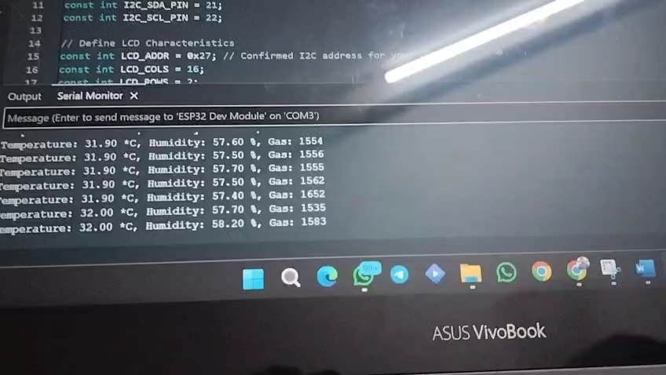
RESULT VIDEO

Slide 10
CONCLUSION
The Air Quality Monitoring System effectively demonstrates real-time sensor integration, data visualization, and IoT-based environmental tracking using a compact embedded system. With ESP32 at its core, the solution offers cost-efficiency, flexibility, and ease of deployment in indoor environments. Data visibility through both LCD and Blynk cloud adds to its robustness.
This project successfully blends analog sensing, digital processing, and cloud transmission in a compact architecture, reinforcing key principles in embedded systems, IoT networking, and environmental monitoring.

Slide 11
FUTURE IMPROVEMENTS
Upgrade to DHT22 for better precision.
Add alerts and thresholds for air pollution detection.
Implement graphical dashboard in Blynk with history storage.
Introduce battery + solar power for remote deployment.
Extend to LoRa/NRF24L01 for long-range communication.

Slide 12


